Slide 1
Supplementary File
2023.12.12

Slide 2
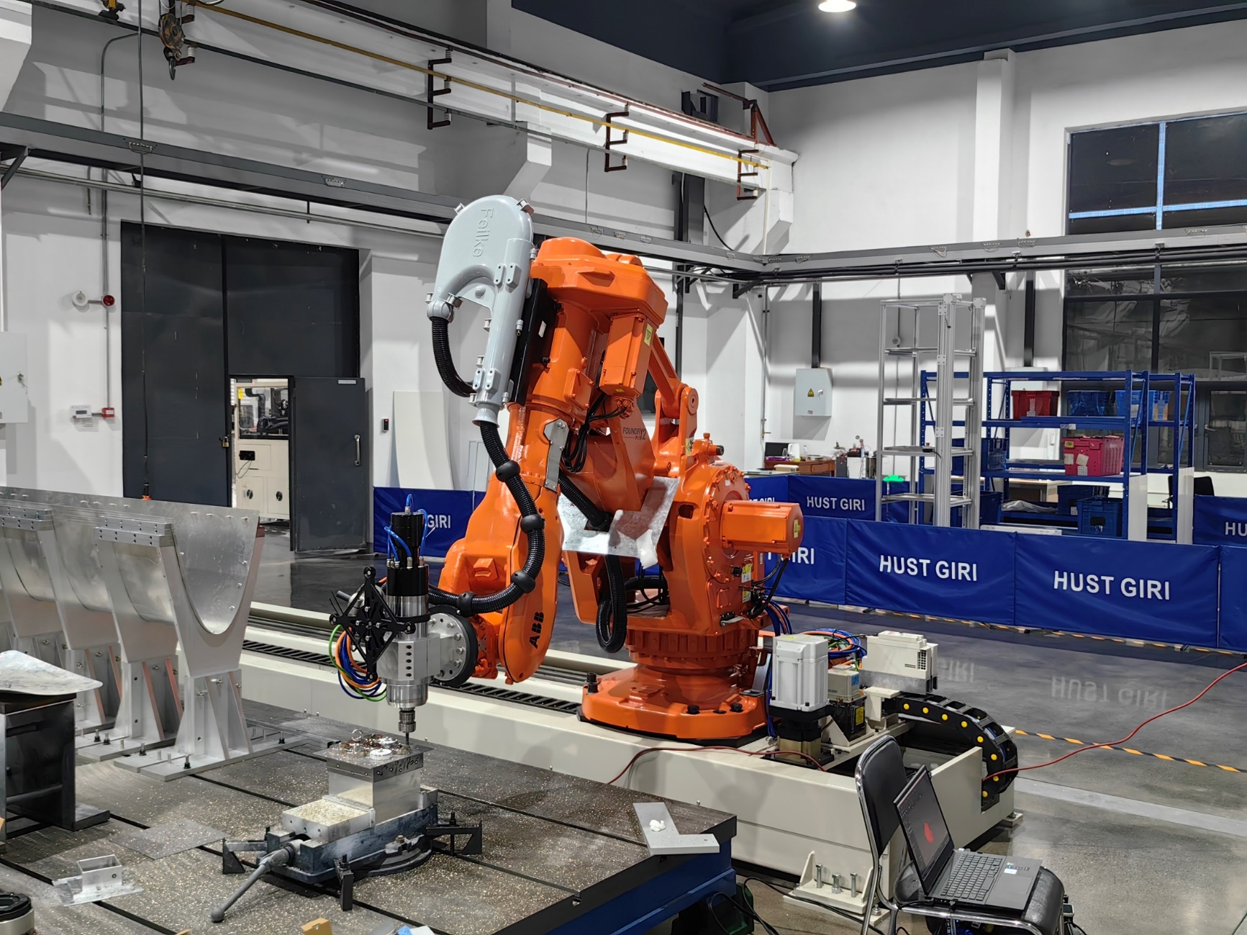
Robotic milling platform
Actual Robotic milling

Slide 3
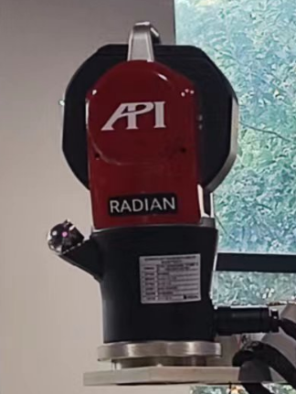
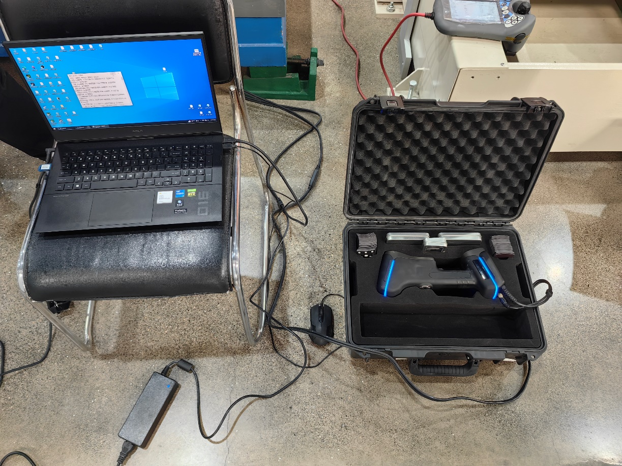
Measurement equipment
Laser tracker
3D Scanner

Slide 4
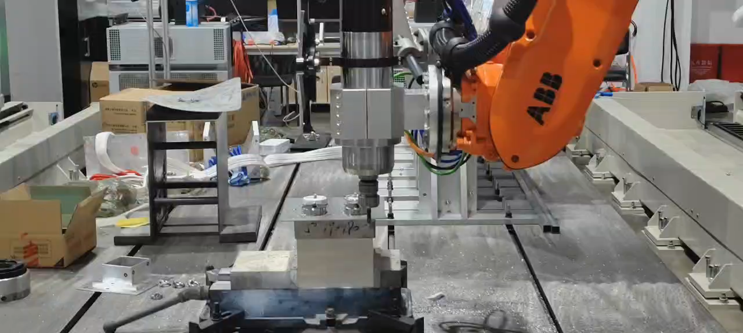
Actual milling
Due to file size limitations, we uploaded a portion of the milling videos
Actual milling: square skin parts

Slide 5
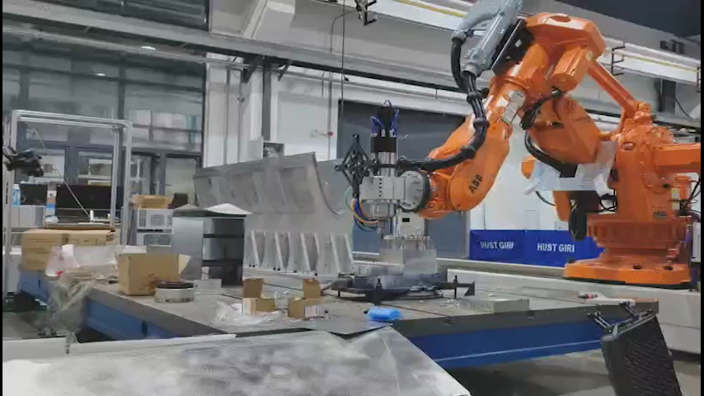
Actual milling
Due to file size limitations, we uploaded a portion of the milling videos
Actual milling: circular skin parts

Slide 6
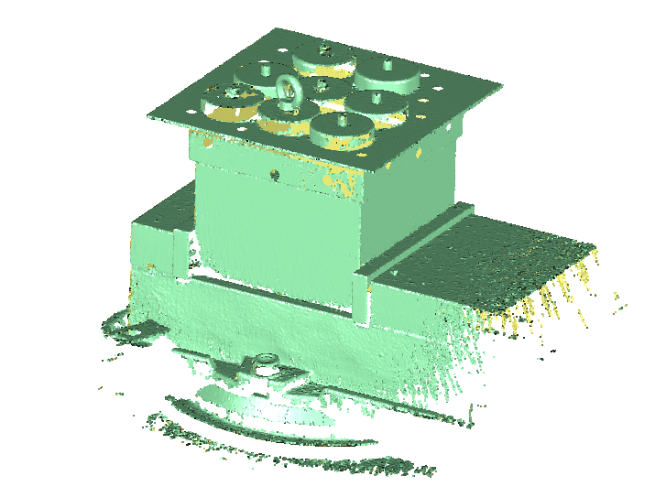
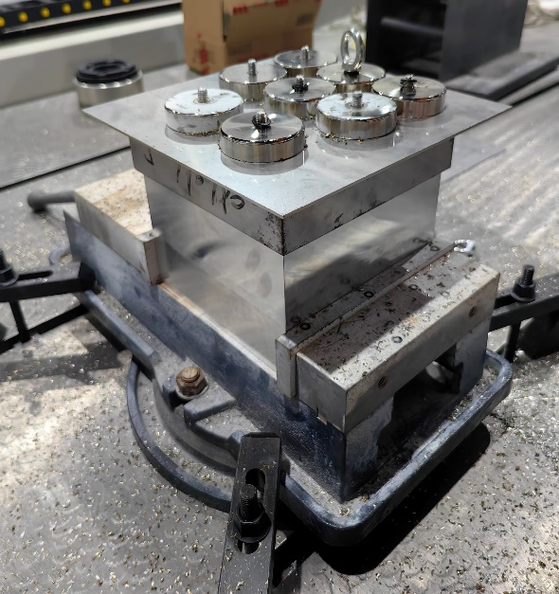
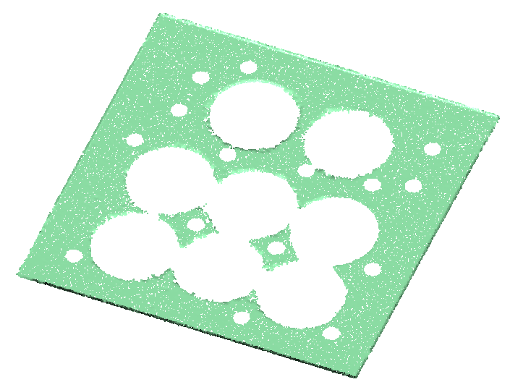
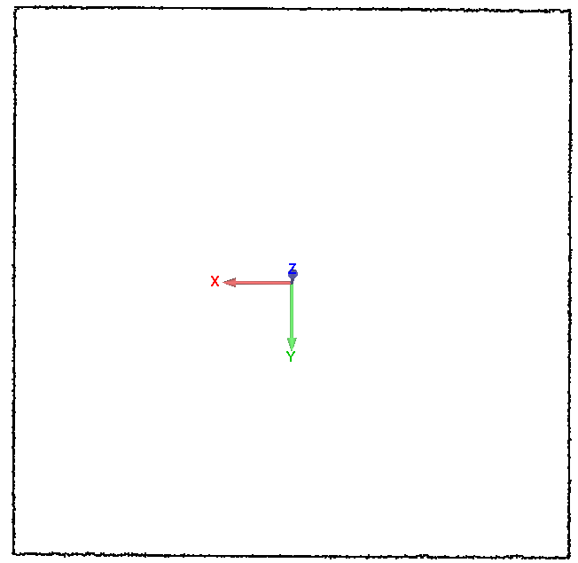
Machining point cloud
Proposed method:
Original measured point cloud
Actual machined skin parts
Skin part point cloud
Boundary point cloud

Slide 7
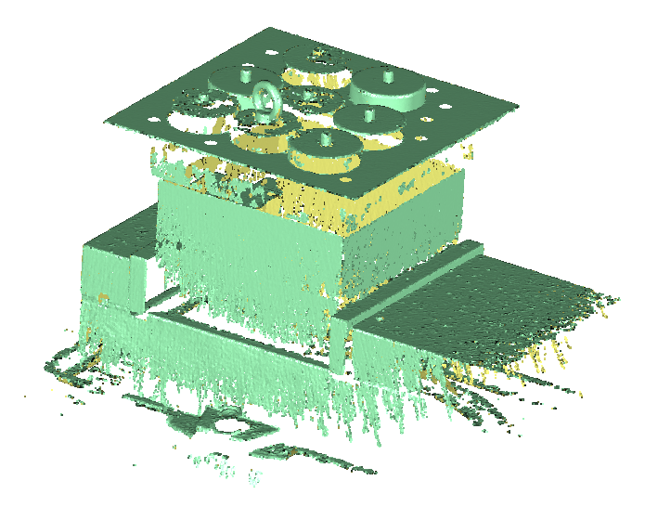
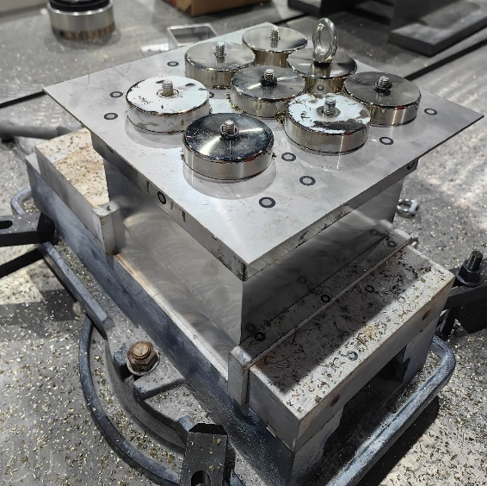
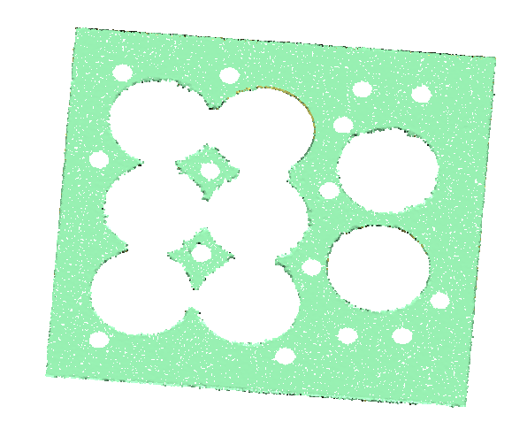
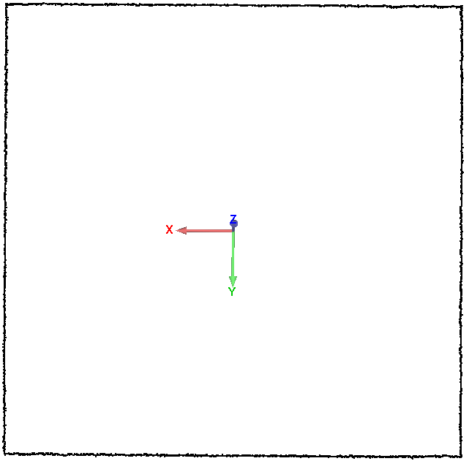
Machining point cloud
LSTM method:
Original measured point cloud
Actual machined skin parts
Skin part point cloud
Boundary point cloud

Slide 8
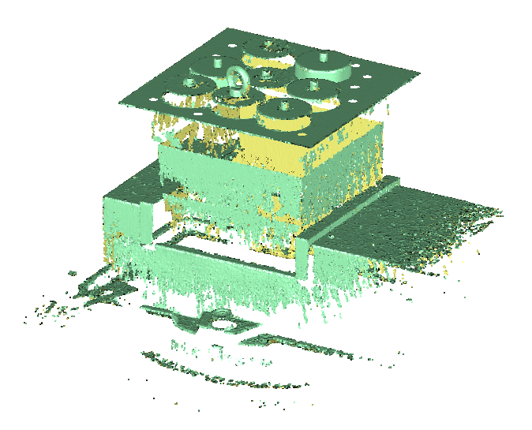
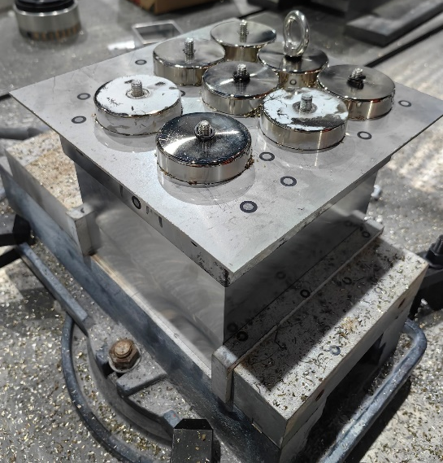
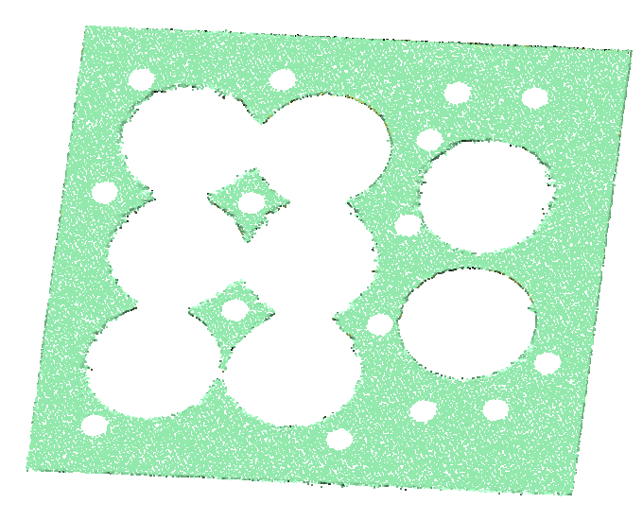
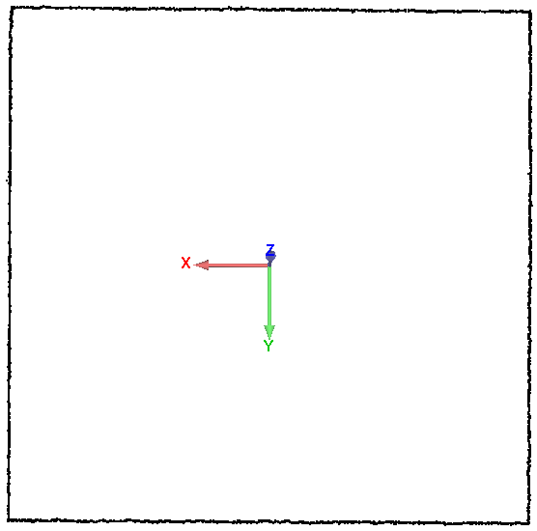
Machining point cloud
DNN method:
Original measured point cloud
Actual machined skin parts
Skin part point cloud
Boundary point cloud

Slide 9
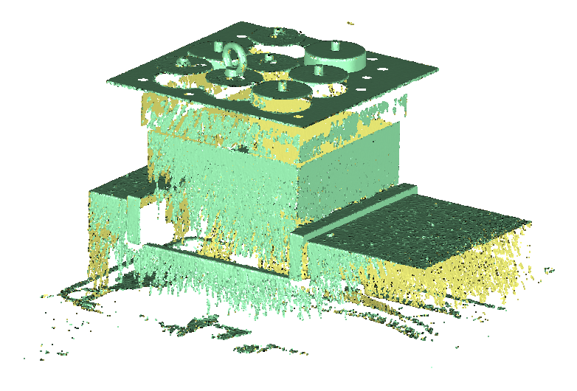
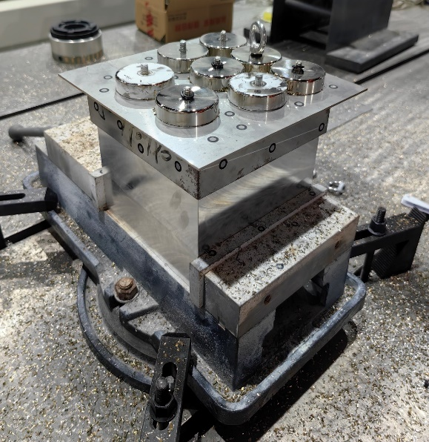
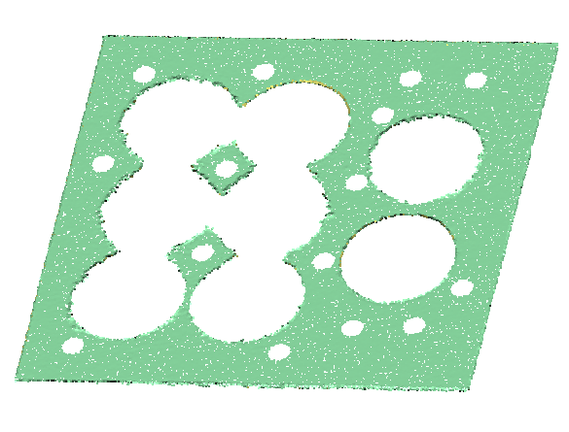
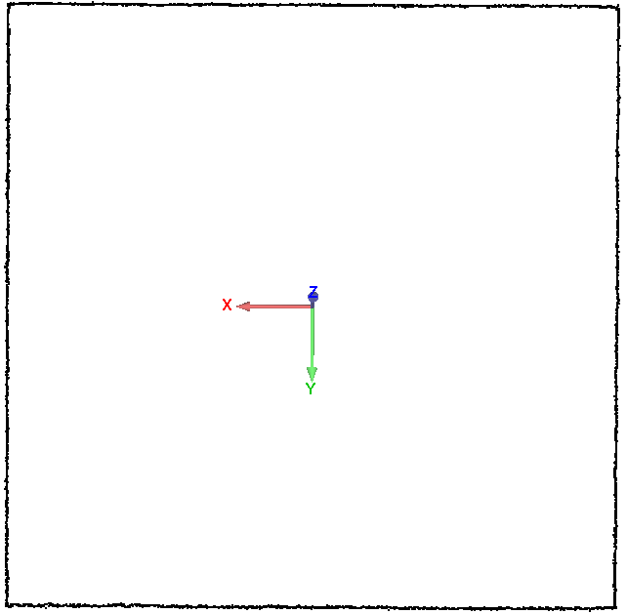
Machining point cloud
Parameter calibration method:
Original measured point cloud
Actual machined skin parts
Skin part point cloud
Boundary point cloud

Slide 10
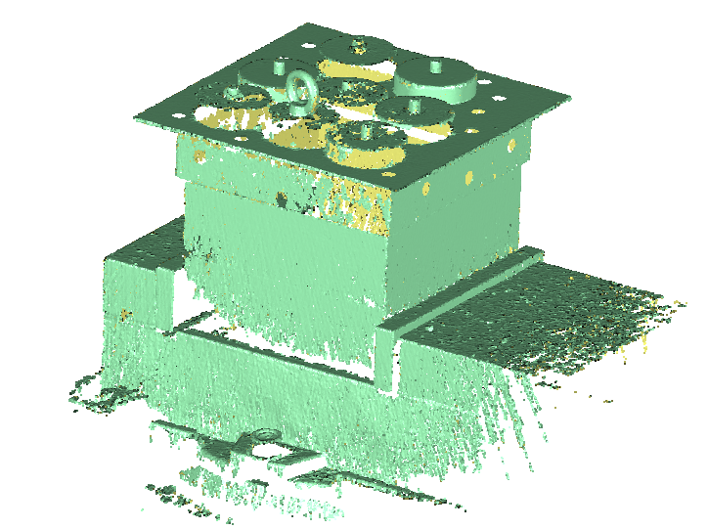
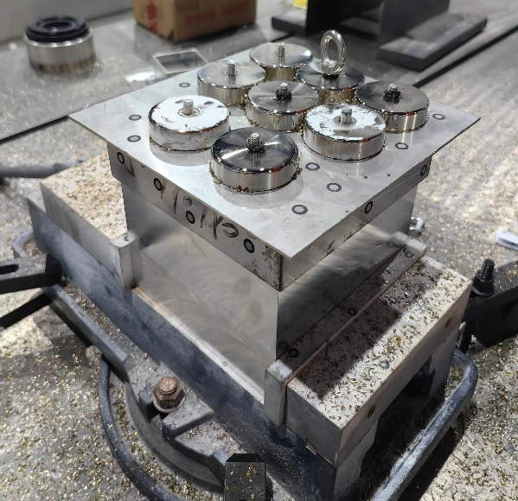
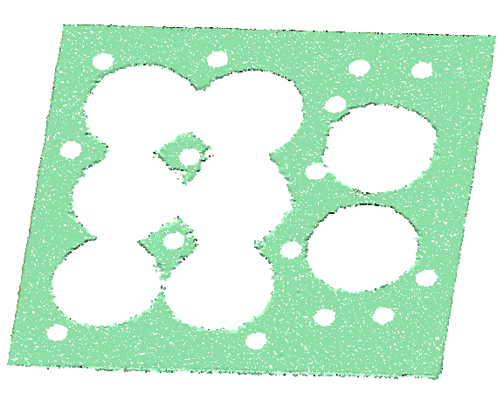
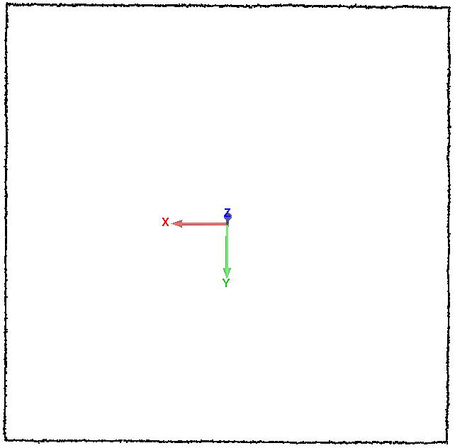
Machining point cloud
Without compensation:
Original measured point cloud
Actual machined skin parts
Skin part point cloud
Boundary point cloud

Slide 11
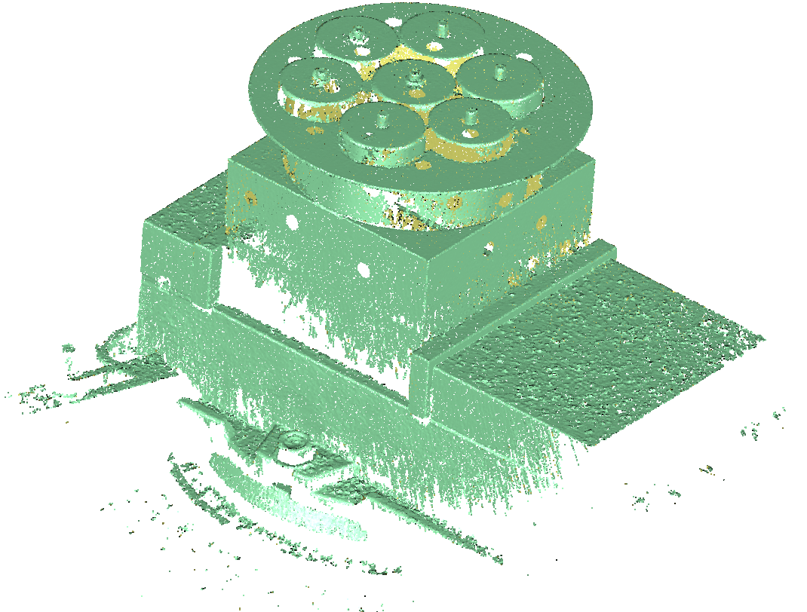
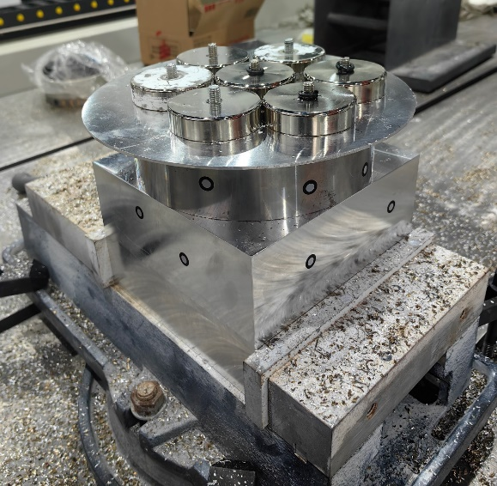
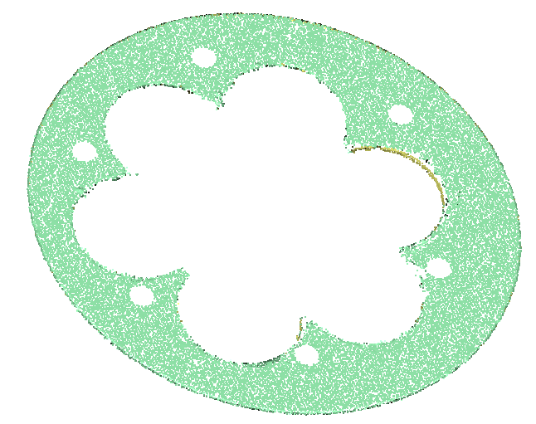
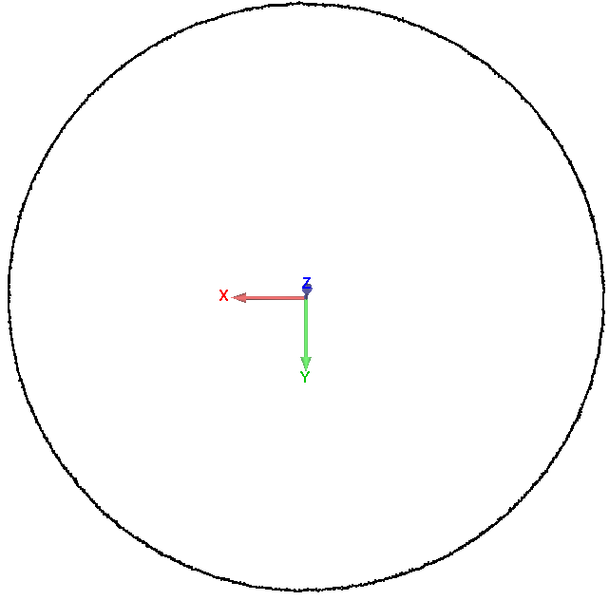
Machining point cloud
Proposed method:
Original measured point cloud
Actual machined skin parts
Skin part point cloud
Boundary point cloud

Slide 12
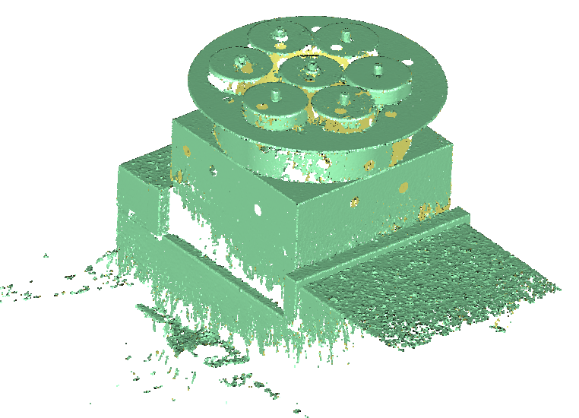
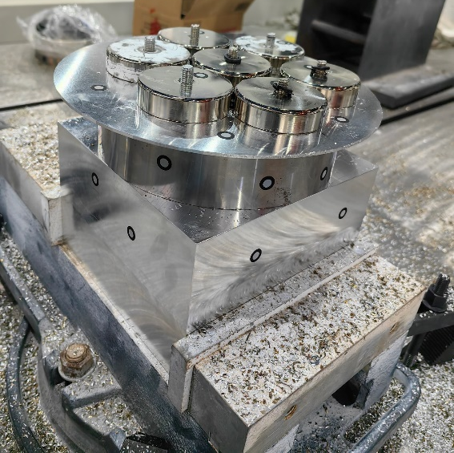
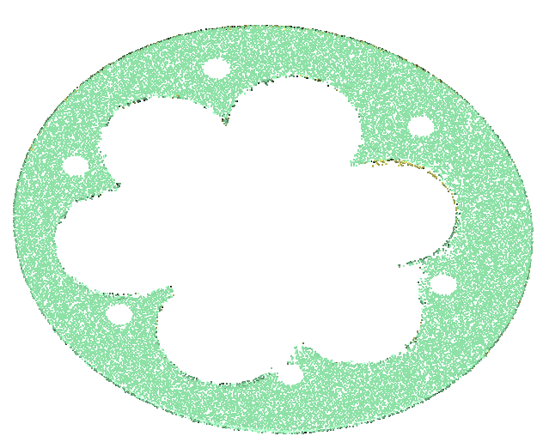
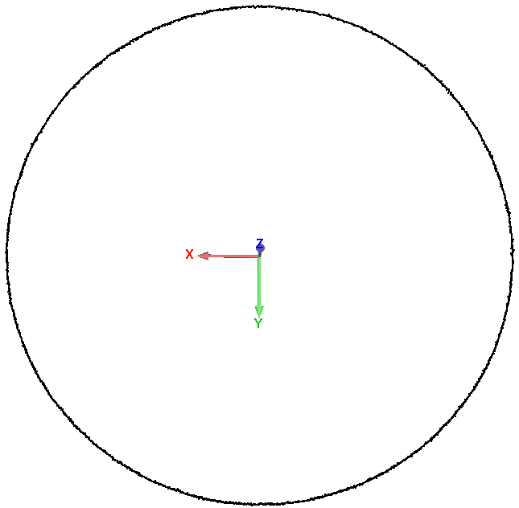
Machining point cloud
LSTM method:
Original measured point cloud
Actual machined skin parts
Skin part point cloud
Boundary point cloud

Slide 13
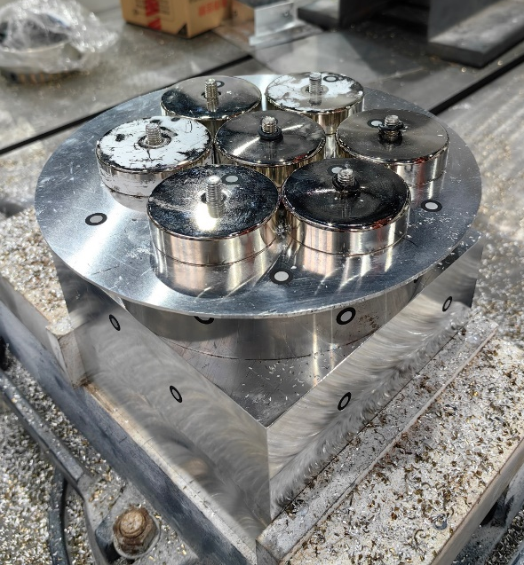
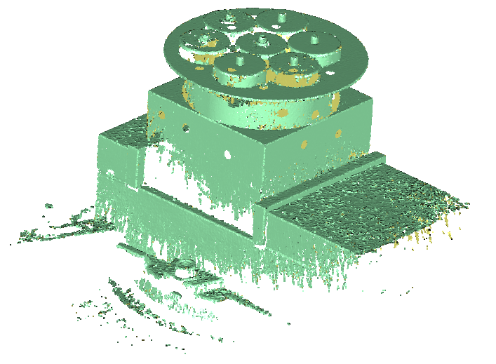
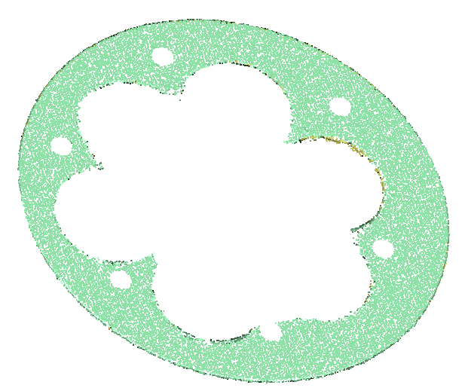
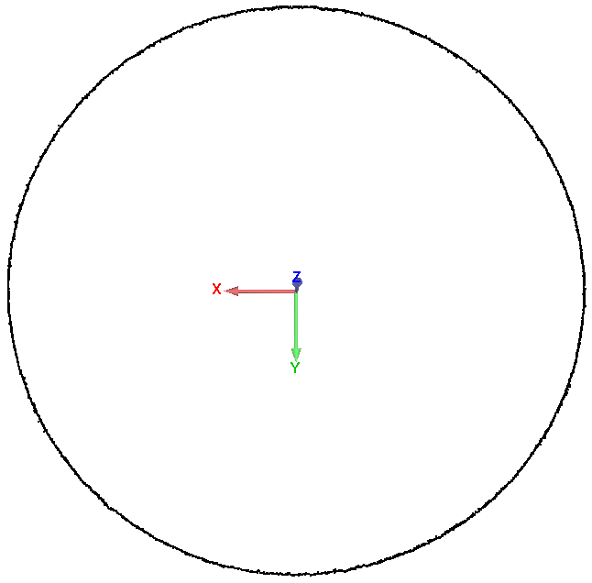
Machining point cloud
DNN method
Original measured point cloud
Actual machined skin parts
Skin part point cloud
Boundary point cloud

Slide 14
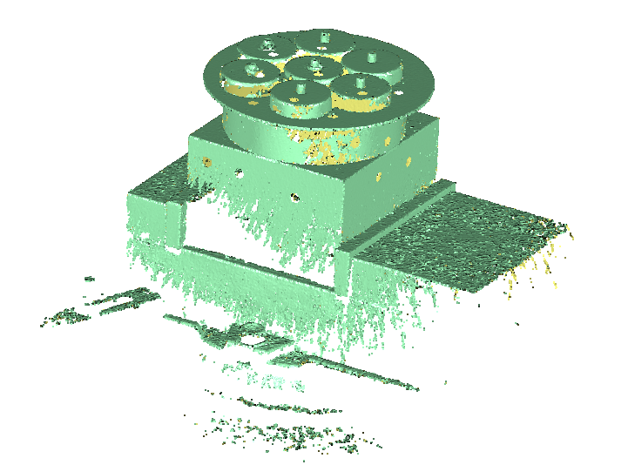
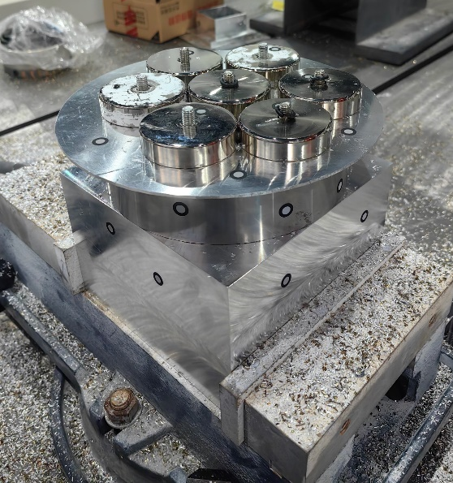
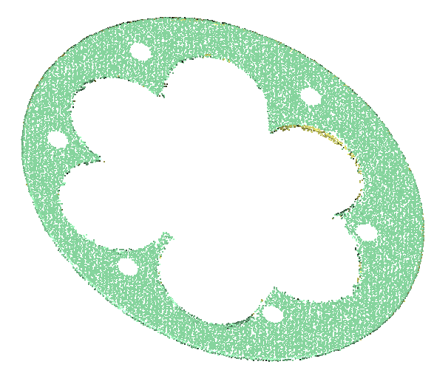
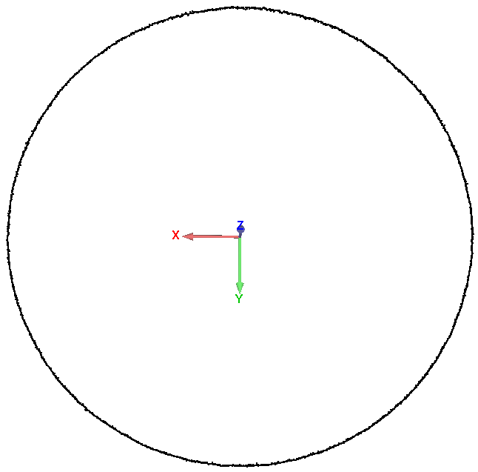
Machining point cloud
Parameter calibration method
Original measured point cloud
Actual machined skin parts
Skin part point cloud
Boundary point cloud

Slide 15
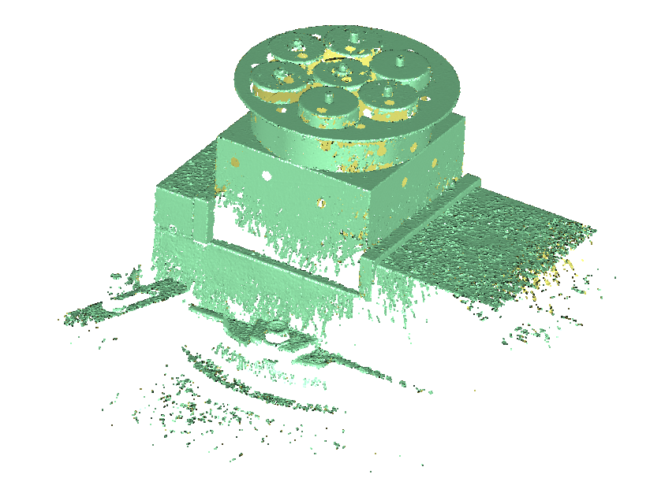
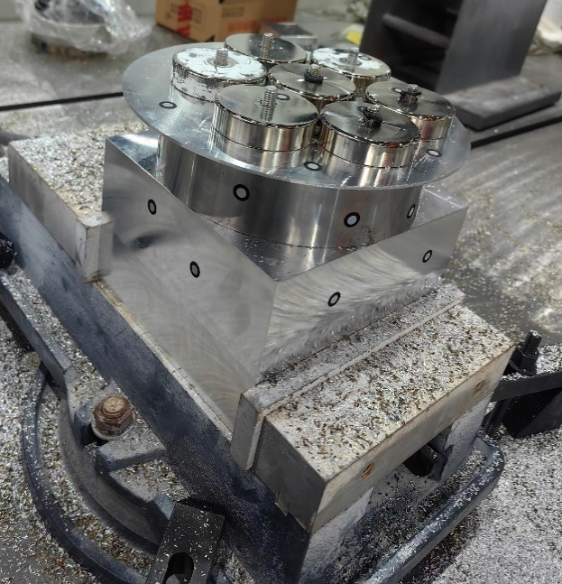
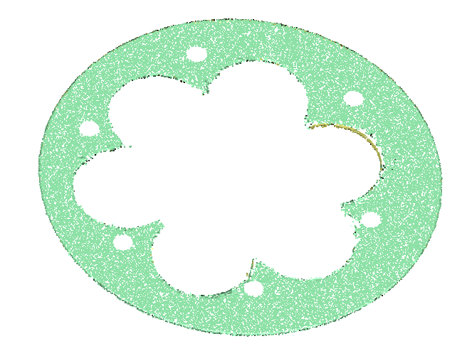
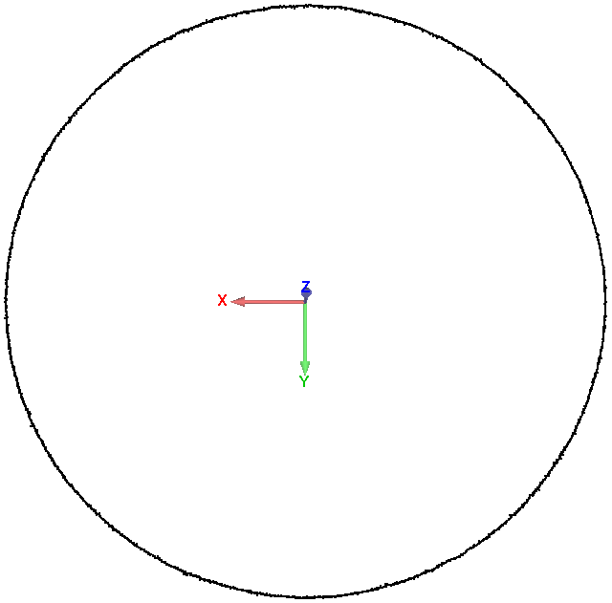
Machining point cloud
Without compensation
Original measured point cloud
Actual machined skin parts
Skin part point cloud
Boundary point cloud

